Slide 1



Interactive mathematical biology
how to create your first shiny app
Dr Thomas E. Woolley, woolleyt1@cardiff.ac.uk, @ThomasEWoolley

Slide 2
Preliminaries:
R: https://www.r-project.org/
http://bit.ly/SMB2021_Link1
Developer environment: https://www.rstudio.com/products/rstudio/download/
http://bit.ly/SMB2021_Link2
install.packages("shiny");
Shiny account: https://www.shinyapps.io/
http://bit.ly/SMB2021_Link3
Github account: https://github.com/
http://bit.ly/SMB2021_Link4
Tutorials:
https://shiny.rstudio.com/tutorial/
http://bit.ly/SMB2021_Link5
https://www2.stat.duke.edu/courses/Spring20/sta199.002/slides/r-shiny.html#1
http://bit.ly/SMB2021_Link6

Slide 3
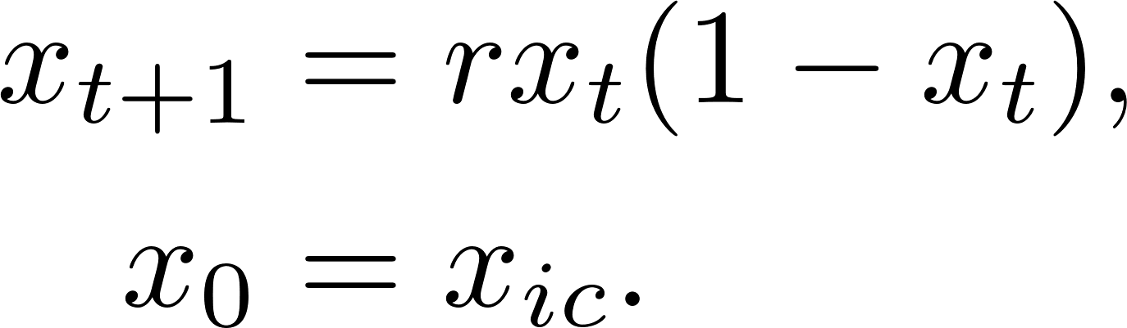



Logistic Equation
Model of a population, $x_{t}$, over discrete time units, $t$, undergoing reproduction and binary competition
$0≤x_{ic}≤1$ is the initial condition
$0≤r≤4$ is the reproduction rate
Chaos

Slide 4

library(shiny)
ui <- fluidPage(
)
server <- function(input, output) {
}
shinyApp(ui = ui, server = server)

Slide 5
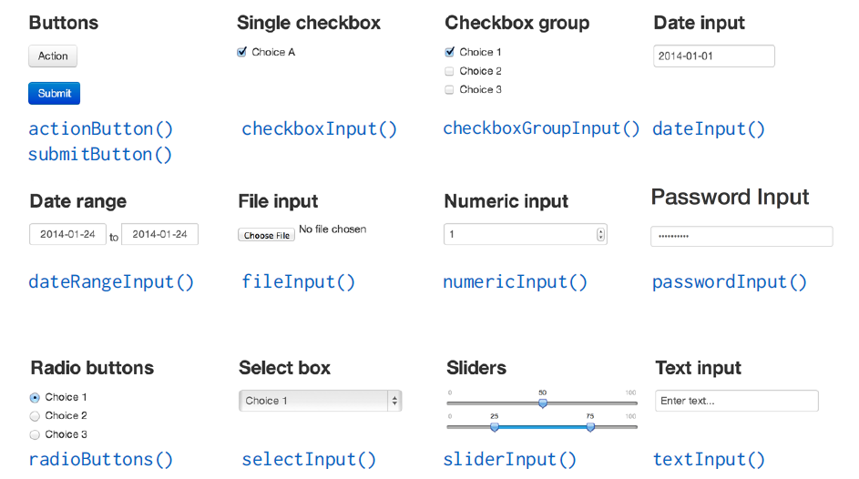

Slide 6
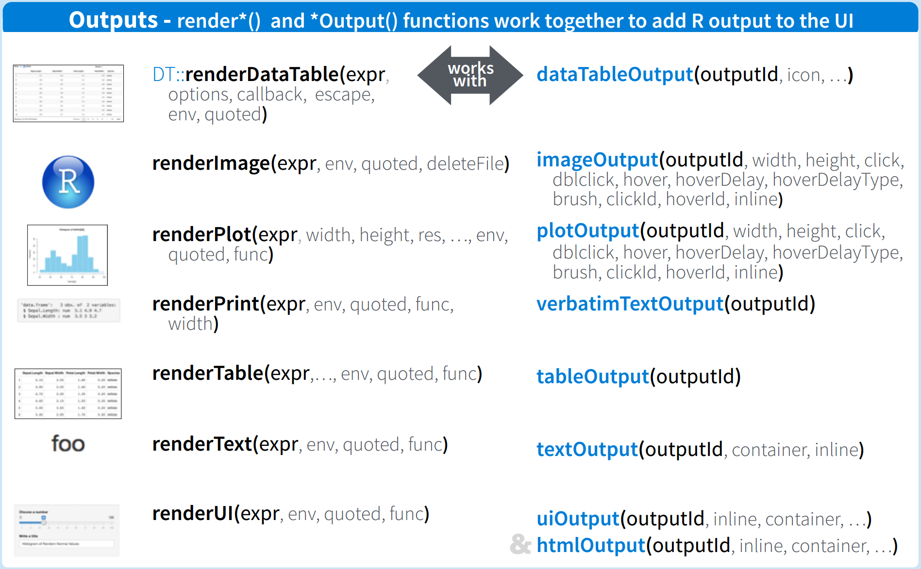

Slide 7
Codes and apps
https://github.com/ThomasEWoolley/Discrete_logistic_equation
http://bit.ly/SMB2021_Link7
https://thomasewoolley.shinyapps.io/Discrete_logistic_equation
http://bit.ly/SMB2021_Link8
https://thomasewoolley.shinyapps.io/Live_coding/
http://bit.ly/SMB2021_Link9

